Slide 1
Continuation of Go2 Navigation Project Process Book
Trevecca Nazarene University
Web Portfolio Capstone Experience
CIT-4960-O003
Project B
Joshua T. Lomelino

Slide 2
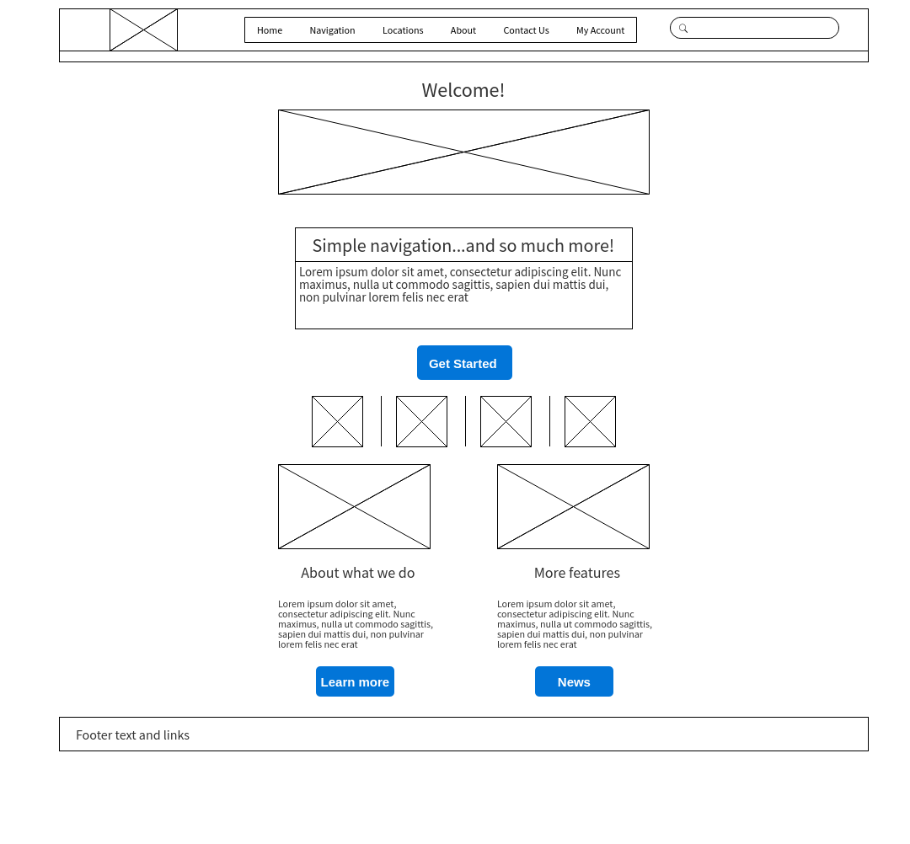
Original Home Page Design, Re-rendered

Slide 3
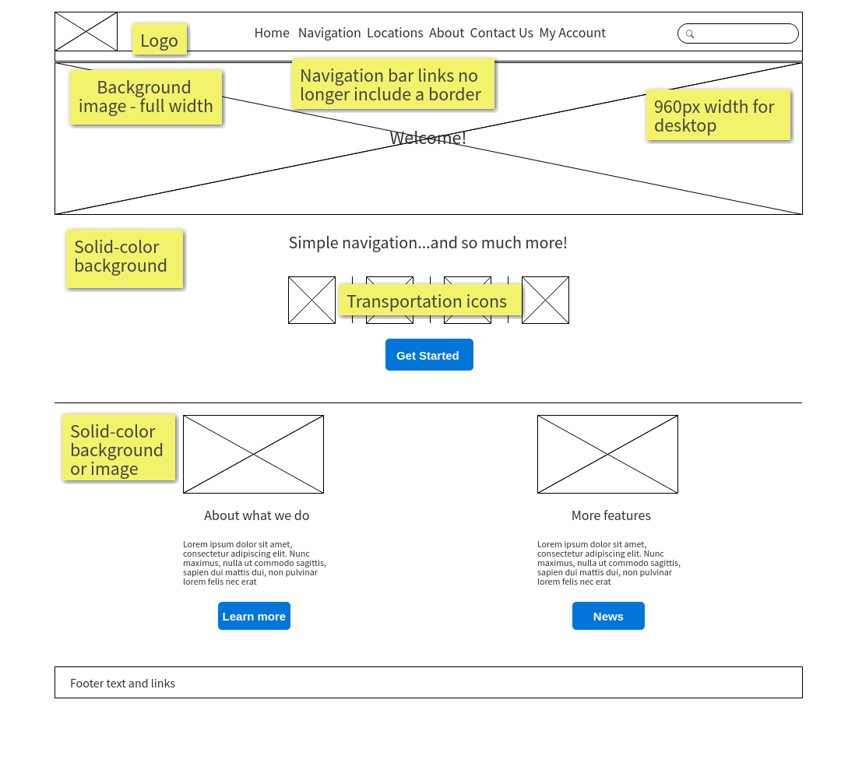
New Home Page Design, basic mockup

Slide 4
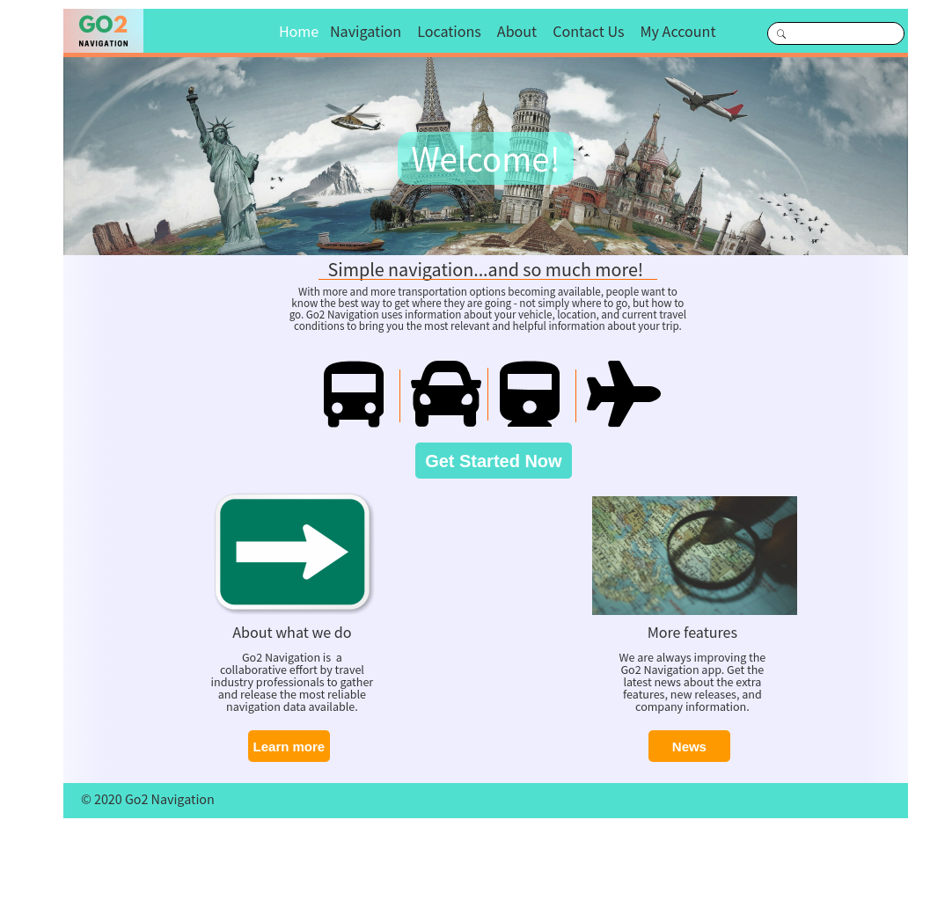
Home Page Design, refinished

Slide 5
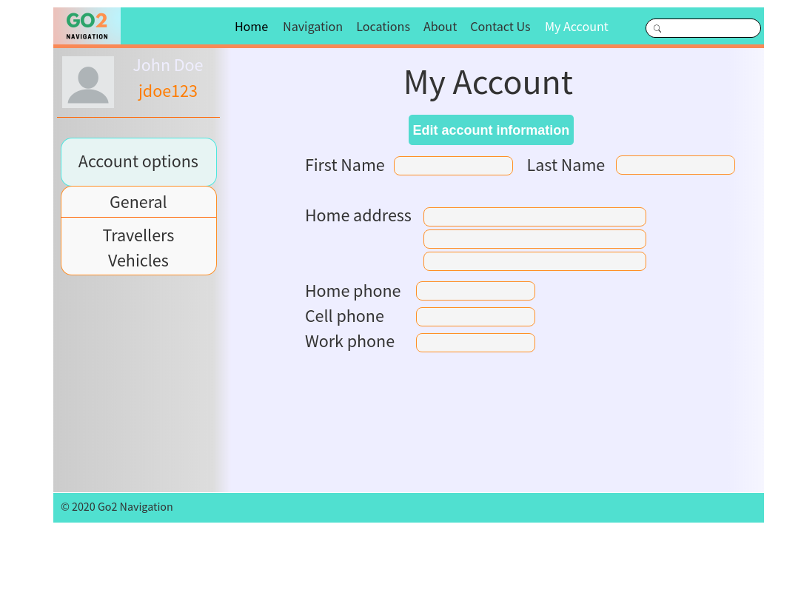
Account page

Slide 6
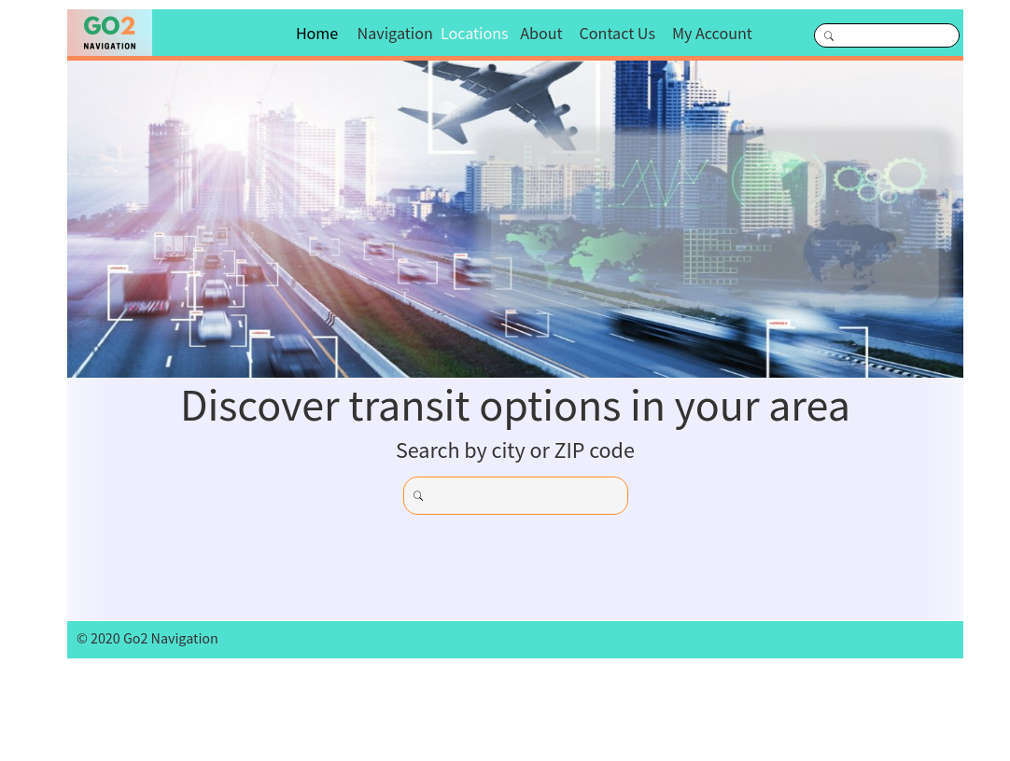
Locations page

Slide 7
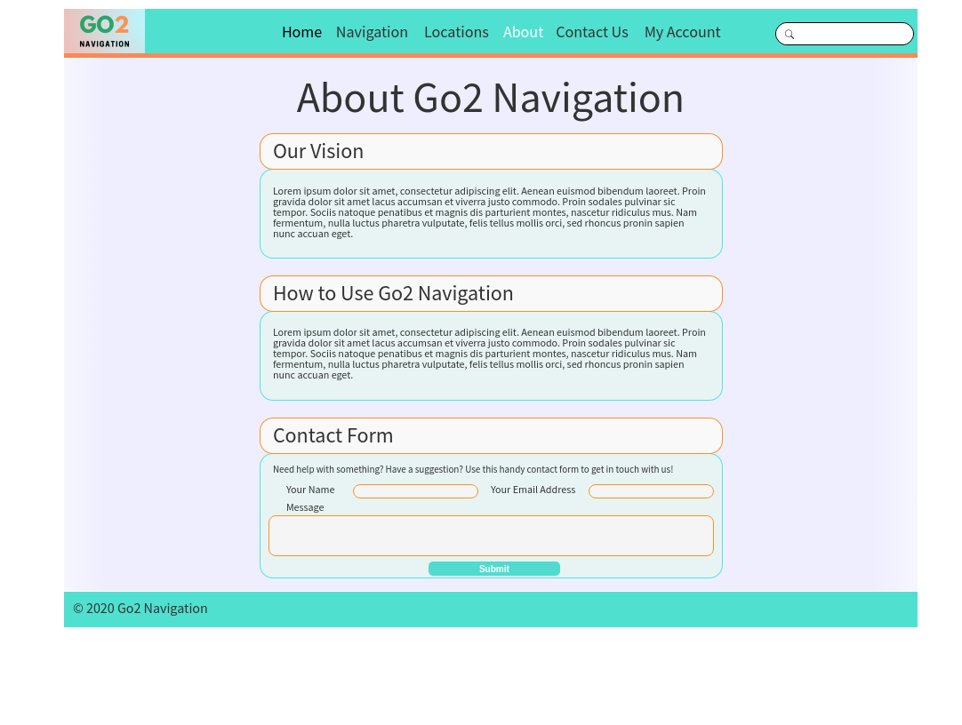
About page

Slide 8
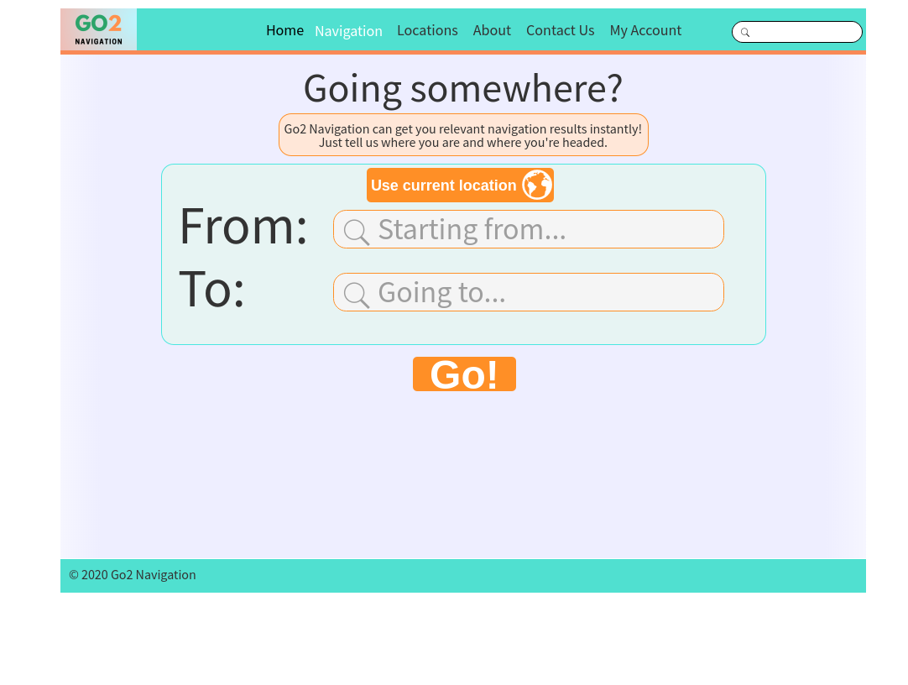
Navigation input page

Slide 9
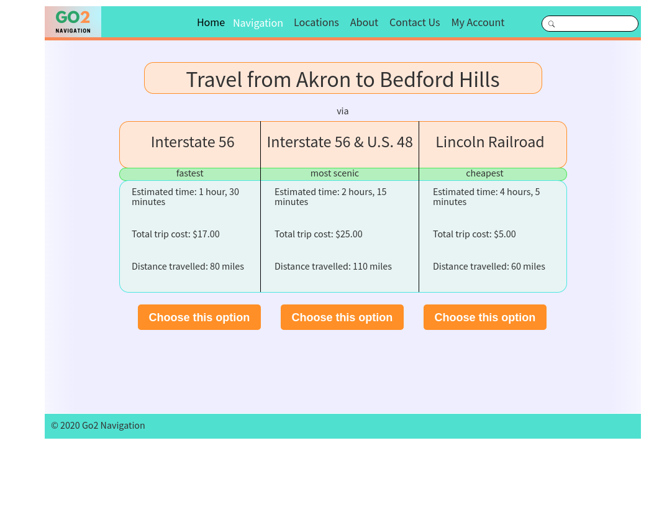
Navigation results page

Slide 10
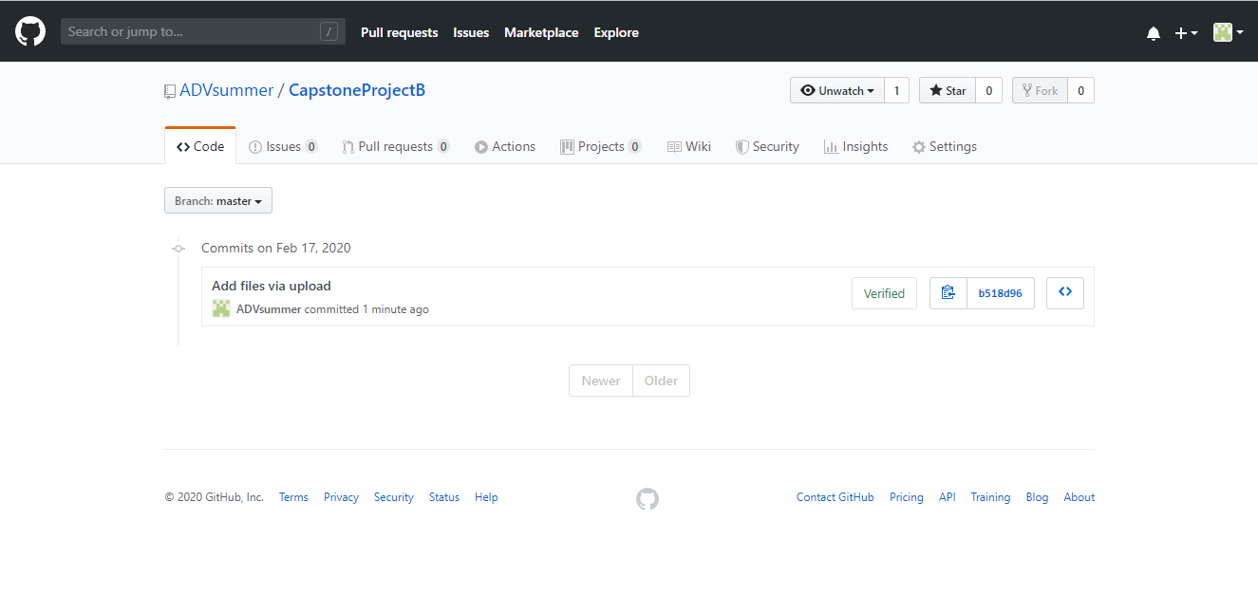
GitHub repo commit history

Slide 11
Change documentation
Mobile versions of the home page and account page have been designed.
On the initial sketch, the mobile version of the home page did not have a large image, a "Welcome!" message, or the transportation icons. However, I feel that this did not provide enough content above the fold, so they were added back to the design without feeling too cluttered.
When the mobile version of the home page is scrolled down, the modules toward the bottom of the page (About what we do" and "More features") include a header, text, and button, but not the image from the desktop version.
Based on some feedback, the desktop version of the account page has been redesigned. The gradient transition from the left sidebar to the background fill color has been removed and replaced with a clean break between the sidebar and page background. Because of this change, a more neutral gray color and black text color were chosen for the sidebar.
The position and size of the input fields on the desktop version of the account page have also been rearranged. Smaller text labels are present.
The changes to the desktop version of the account page have also been incorporated into the mobile version of the account page.

Slide 12
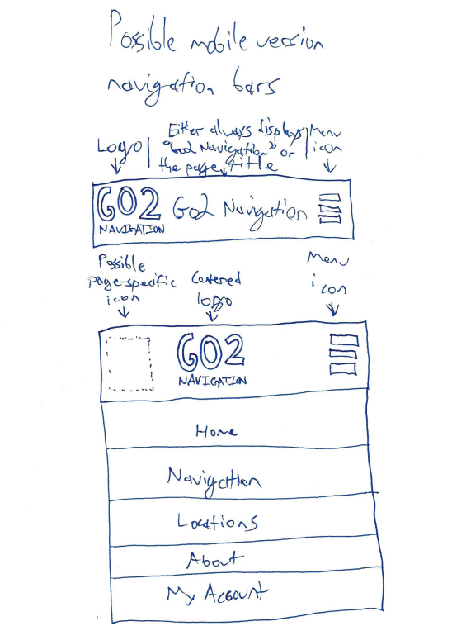
Mobile version sketch – navigation bar and menu

Slide 13
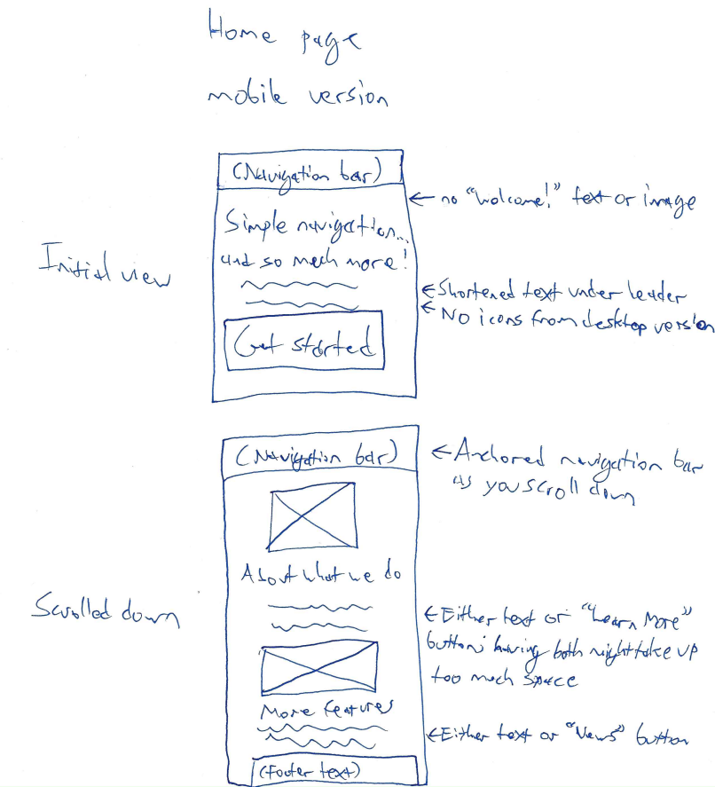
Mobile version sketch – home page

Slide 14
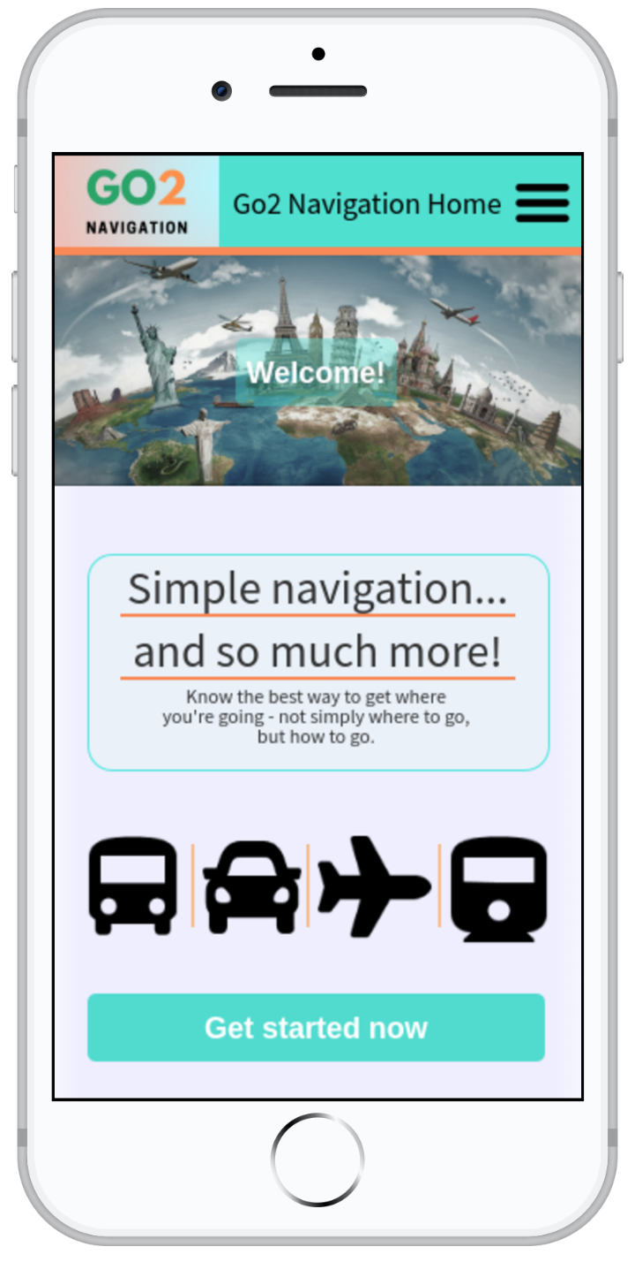
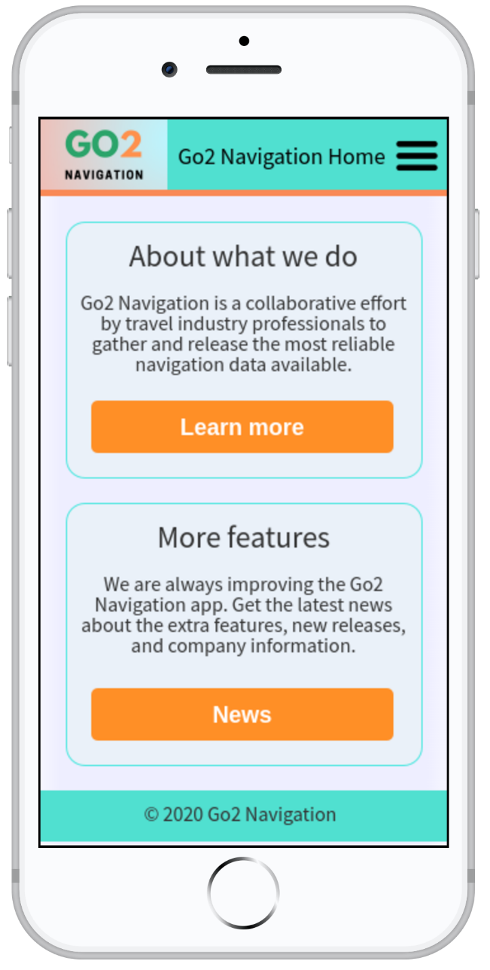
Home page mobile version mockups

Slide 15
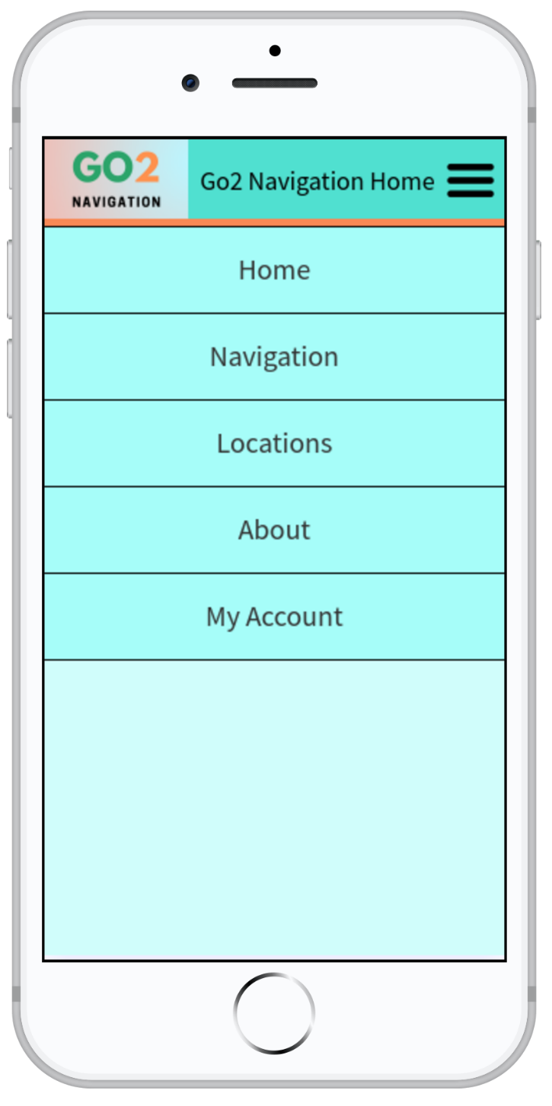
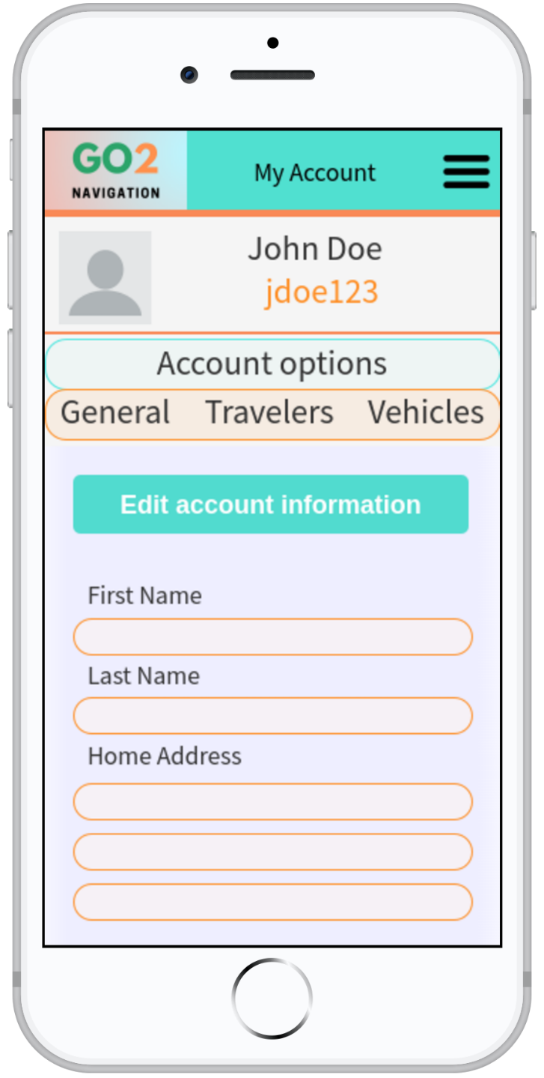
Active menu and account page mobile version mockups

Slide 16
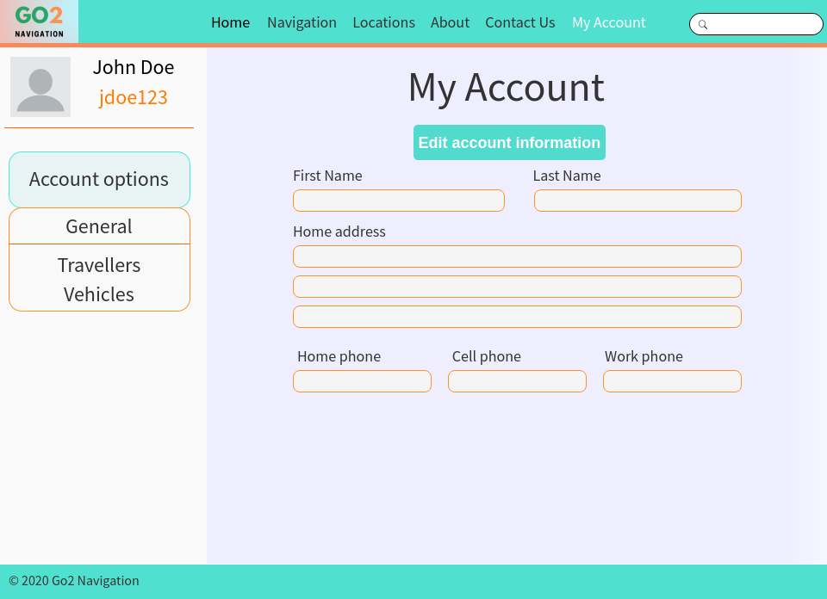
Revised account page – desktop version

